Slide 1

Special Considerations for Practicing in Youth Sport
Rob Anderson
June 9th 2018

Slide 2
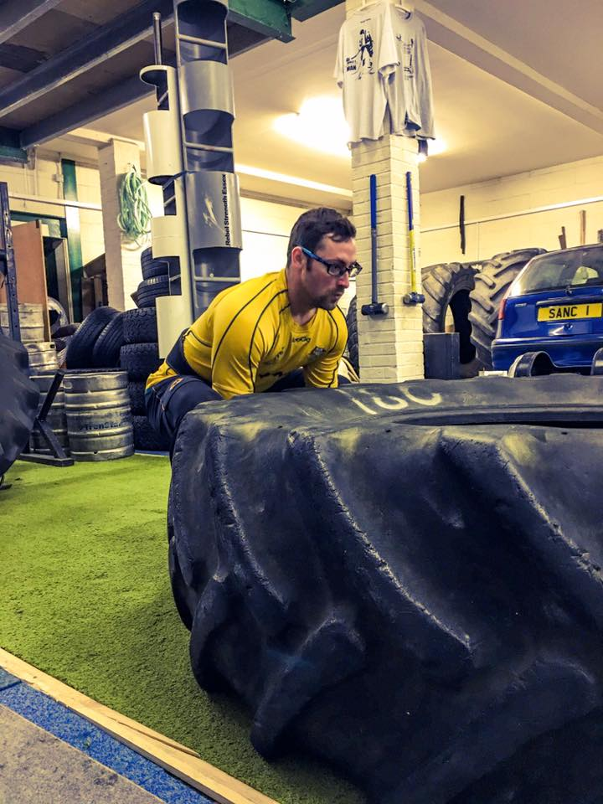
Who am I?
BSc (Hons) Strength & Conditioning Science
MSc in Applied Sport and Exercise Physiology
UKSCA Accredited since 2010
Scottish Rugby Academy Strength and Conditioning Coach Borders & East Lothian
World Rugby Educator Strength and Conditioning
Specific interest in Long Term Youth Athlete Development

Slide 3


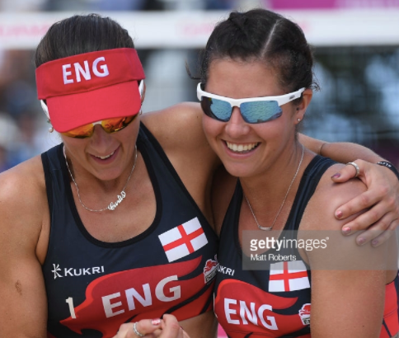
Who am I?

Slide 4
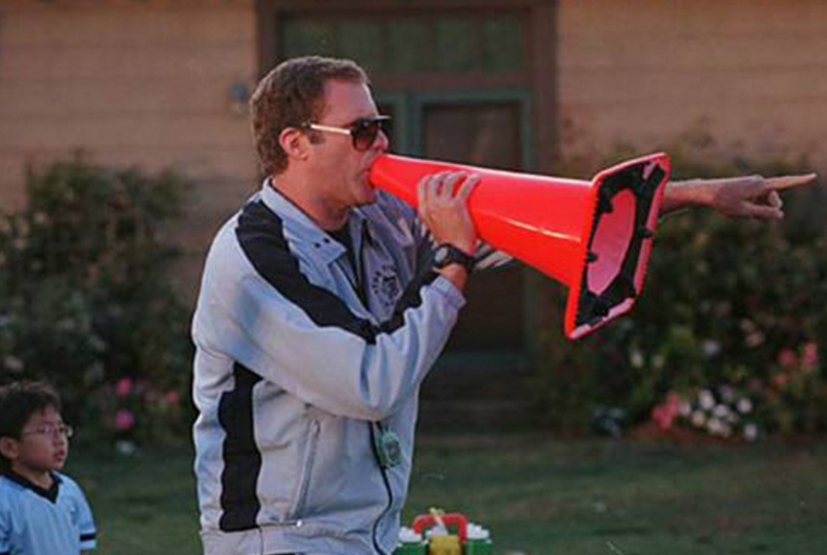
Overview
Why youth athletes aren’t mini-adults
The unique challenges facing youth athletes and their coaches
Myths and fallacies of training youth athletes
How to integrate physical preparation into technical sessions
Practical session
Q&A

Slide 5

Why youth athletes aren’t mini adults
Growth and maturation:
Physical (skeletal, muscular, hormonal, anaerobic enzymes)
Neural (neural plasticity)
Psychologically/Cognitive (attention, focus, discipline)

Slide 6
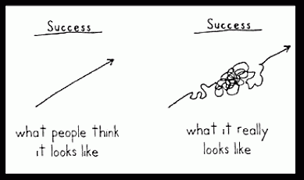
Unique challenges facing youth athletes/coaches
Growth and maturation:
Periods of growth (height, weight), often rapid (PHV/PWV)
Increases in Testosterone and Growth hormone

Slide 7
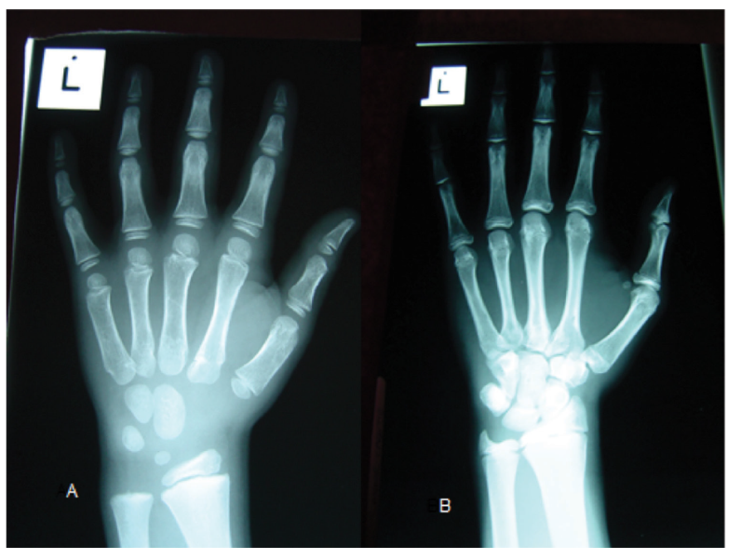
Unique challenges facing youth athletes/coaches
Rate of maturation:
Non-linear in nature
Early/on-time/late maturers
Two players with chronological birthdates within 1 week. Player A has a skeletal age of 6.3 years and player B 12.1 years, using the Fels method of X-ray assessment. – Aspetar Sports Medicine Journal

Slide 8
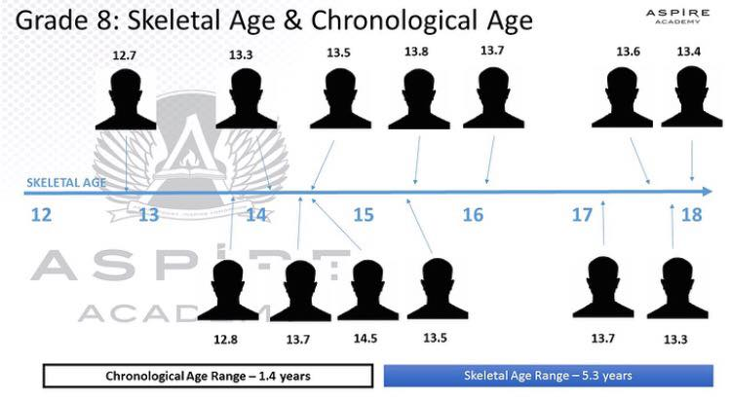
Unique challenges facing youth athletes/coaches
Rate of maturation:
Non-linear in nature
Early/on-time/late maturers

Slide 9
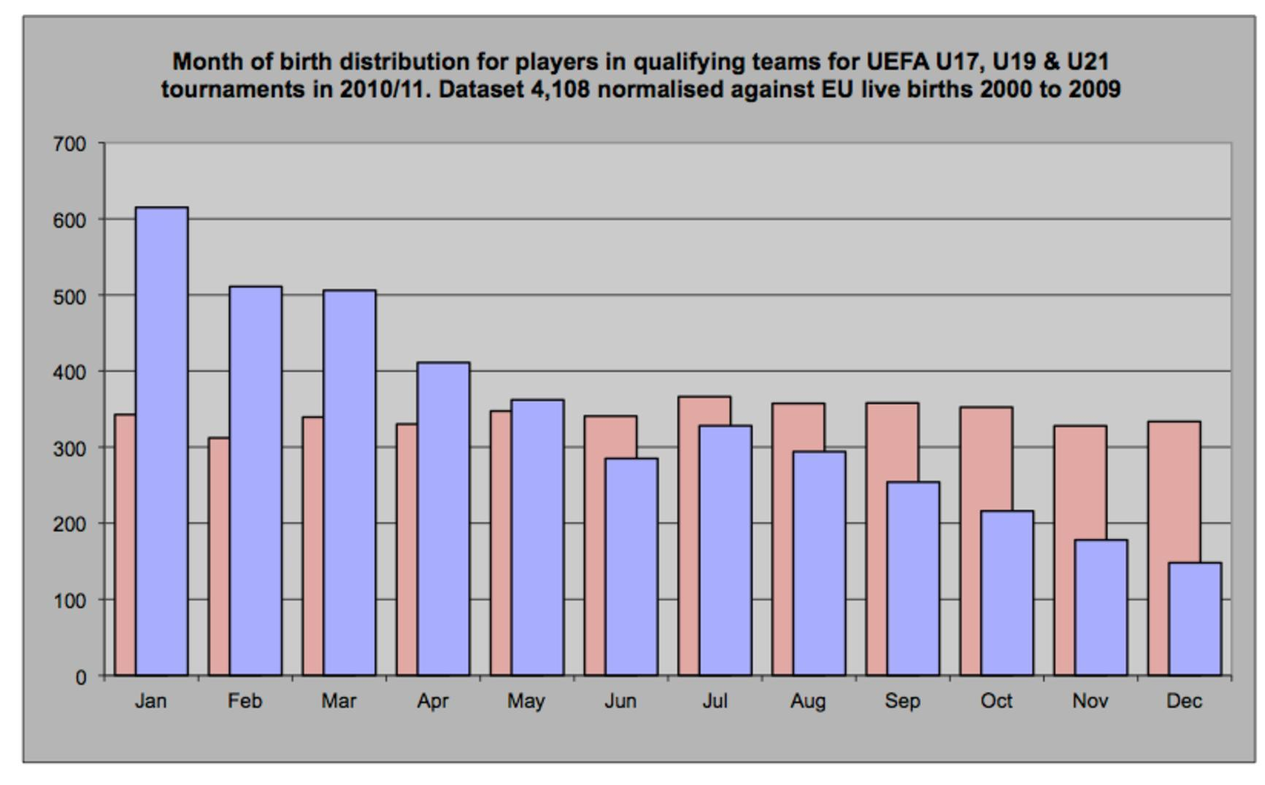
Unique challenges facing youth athletes/coaches
Relative Age Effect:
Over-representation of players born in early
Under-representation of players born later
Usually displayed in quartiles of 3 months each
Usually prevalent in sport where physical elements are key

Slide 10
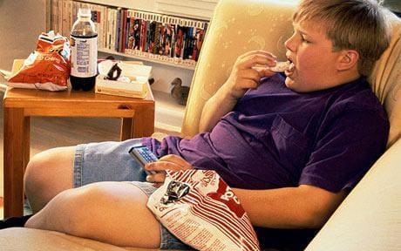

Unique challenges facing youth athletes/coaches
Physical literacy:
Current Society encourages extreme ends
  Early specialisation – single sport participation to high level
  Sedentary children - little to no level of physical literacy
  Resulting in lack of ability to do basic physical tasks

Slide 11
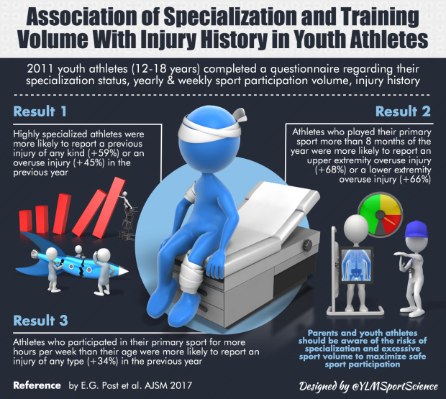
Unique challenges facing youth athletes/coaches
Early specialisation:
Youth athletes specialising earlier
Earlier likelihood of over-use injuries (eg. Tendinopathy)
Poor management of workload (school, club, academy, region, representative)

Slide 12
Potential impacts:
Physical
Lever lengths
Motor Control
Coordination
Mental
Confidence
Social
Range of motion
Skill development
Performance
Dropout
Responses to training
Self Esteem
Injury
Fatigue
Longevity
Talent ID
Talent Pool size
Perception
Muscle Mass
Selection/Deselection
Perceived “Talent”
Relative Age Effect

Slide 13


Key Principles of physical preparation
In an ideal training scenario:
Optimum balance of training/recovery = increased performance, avoid injury
6 Year old Basketballer

Slide 14
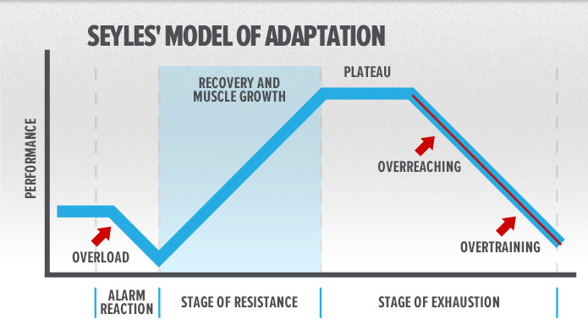
Key Principles of physical preparation
Hans Selye “General Adaptation Syndrome”

Slide 15
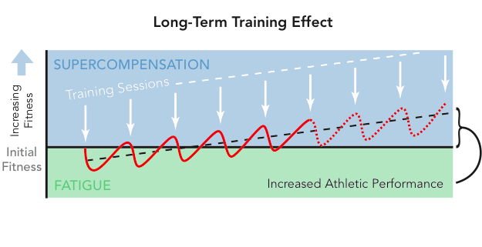
Key Principles of physical preparation
In an ideal training scenario:
Optimum balance of training/recovery = increased performance, avoid injury

Slide 16
Unique challenges facing youth athletes/coaches
Multi-faceted challenge, therefore we as coaches, need to be more holistic in our approach!
Youth Athlete
Growth and Maturation
Rate of Maturation
Relative Age Effect
Early Specialisation
Total Workload
Physical Literacy

Slide 17
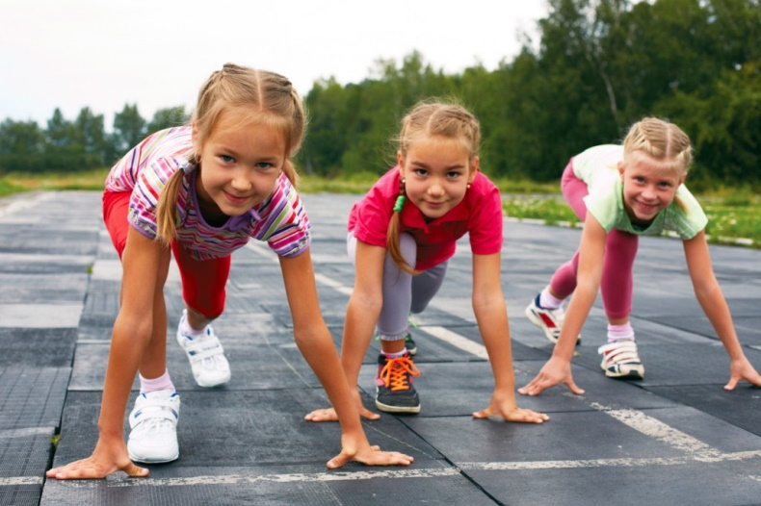
Unique challenges facing youth athletes/coaches
Key take home messages:
Youth athletes are a melting pot of many biopsychosocial factors
The effects of maturation are multi-faceted
The rate of maturation isn’t equal – early/on-time/late
Relative Age Effect prominent in more physical sports
Both sedentary and early-specialisation problematic
Overworked athletes tend to get injured, more ≠ better

Slide 18
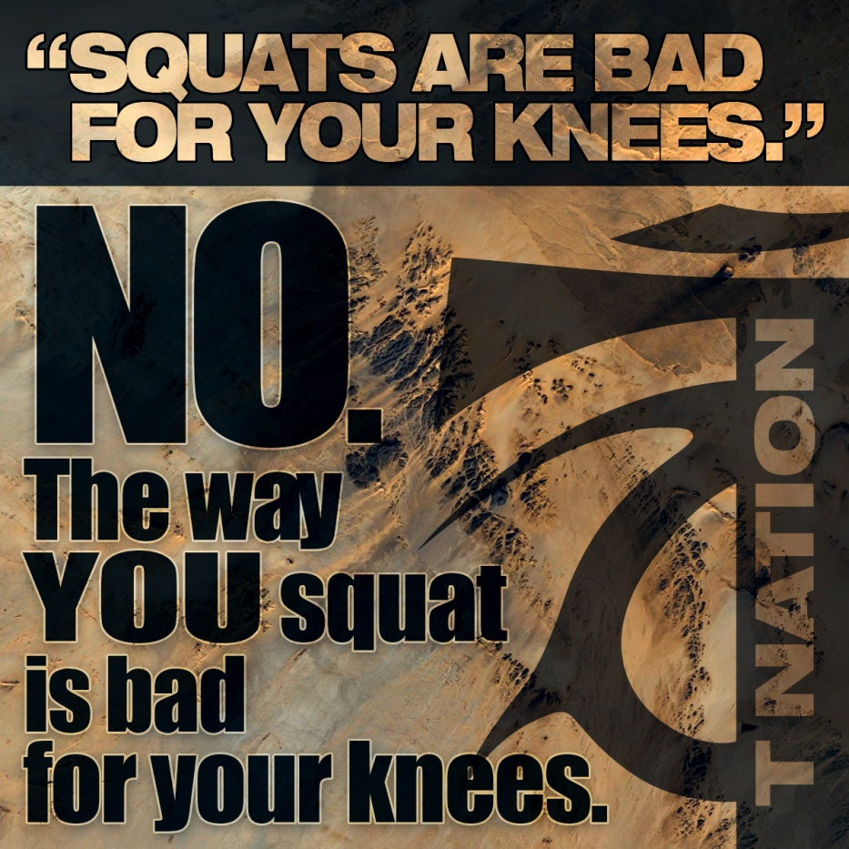
Myths and fallacies of youth training
(Insert exercise) is bad for your (insert bodypart) – FALSE!
Over the course of time, certain exercises have been given bad reputations, usually by people who don’t know how to perform/coach them/pre-existing issues.
Usually the full squat and deadlift.
Think of a sporting skill…
  Is poor technique an injury risk?
  Is improper progression an injury risk?
  Is training volume an injury risk?
  Is improper coaching an injury risk?
Physical training is no different!
Mediate the remaining risk with:
Appropriate training plan
Appropriately trained coach
Appropriate supervision

Slide 19



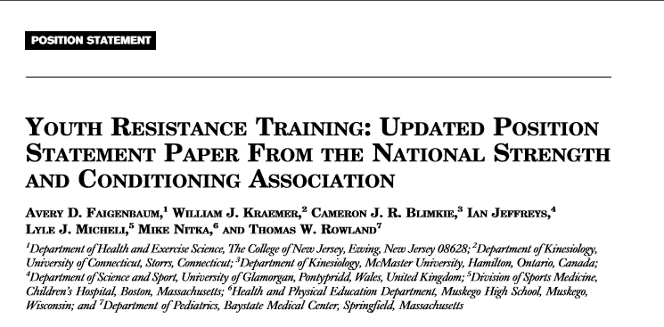
Myths and fallacies of youth training
Strength training isn’t safe for children – FALSE!
UKSCA Position Paper
BASES Position Paper
ASCA Position Paper
American Academy of Paediatrics
NSCA Position Paper

Slide 20
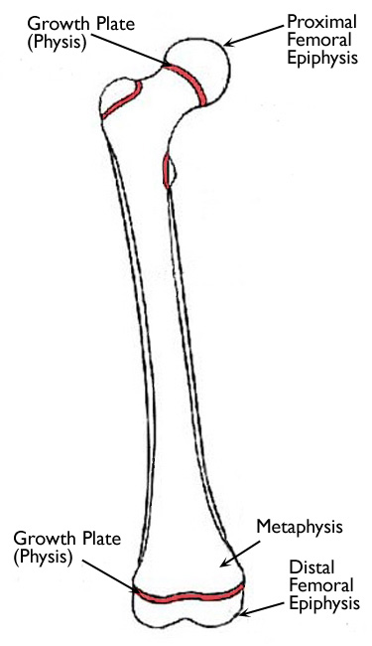
Myths and fallacies of youth training
Weight Training Stunts Growth – FALSE!
Confusion regarding localised “stunting of growth” vs limiting adult stature
Mechanism – trauma to growth/plate and epyphysis
Particularly susceptible during rapid growth
15% of all childhood fracture physis
Most popular causes:
  Falling from bikes, skateboards, trees in 1 study
  In Sport: Hockey, football, baseball – 33.5%
  Skiing, biking, skateboarding – 21.7%
  Contact sport (american football) most reported
You decide: this or this
Mediate the remaining risk with:
Appropriate training plan
Appropriately trained coach
Appropriate supervision

Slide 21
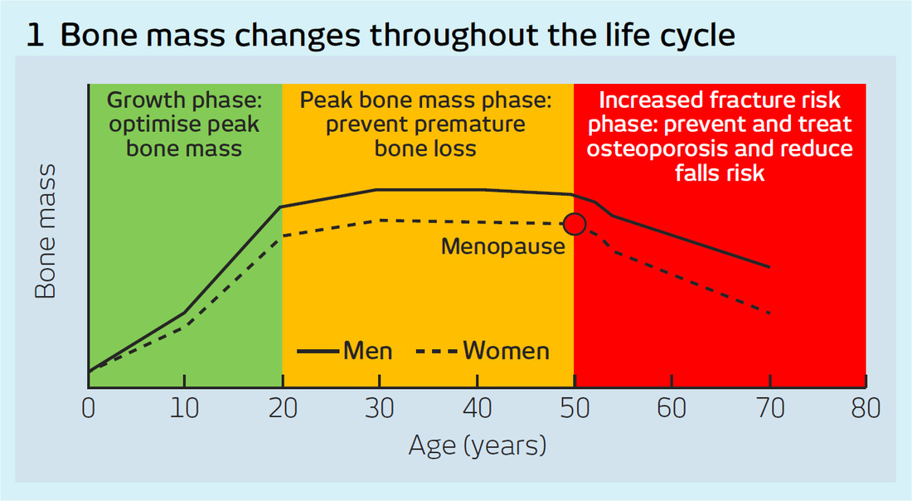

Myths and fallacies of youth training
Weight Training Stunts Growth – FALSE!
In reality:
Bone tissue requires stress for adaptation
BMD shown higher in youth weightlifters vs matched controls/adults
Weight bearing suggested more important than calcium in BMD in adulthood
“Contrary to the majority of these misconceptions however, research suggests that childhood to adolescence is in the fact the most opportune time for bones to respond to the compressive and tensile forces experienced during weight bearing exercise.”
- Strength and Conditioning for Youth Athletes (Lloyd and Oliver)

Slide 22
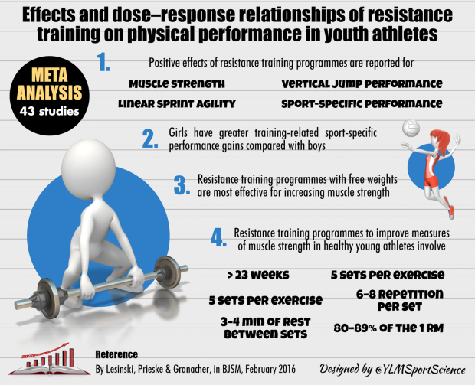
Myths and fallacies of youth training
Children should only do trunk/core training they don’t benefit from strength – FALSE!

Slide 23
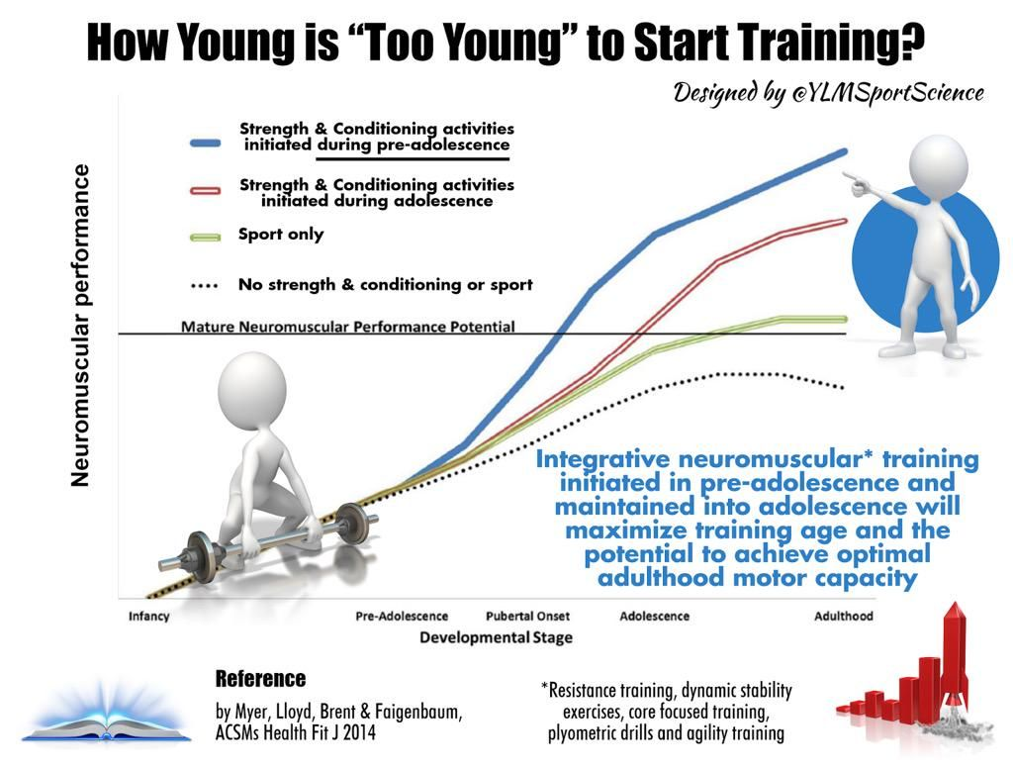

Slide 24
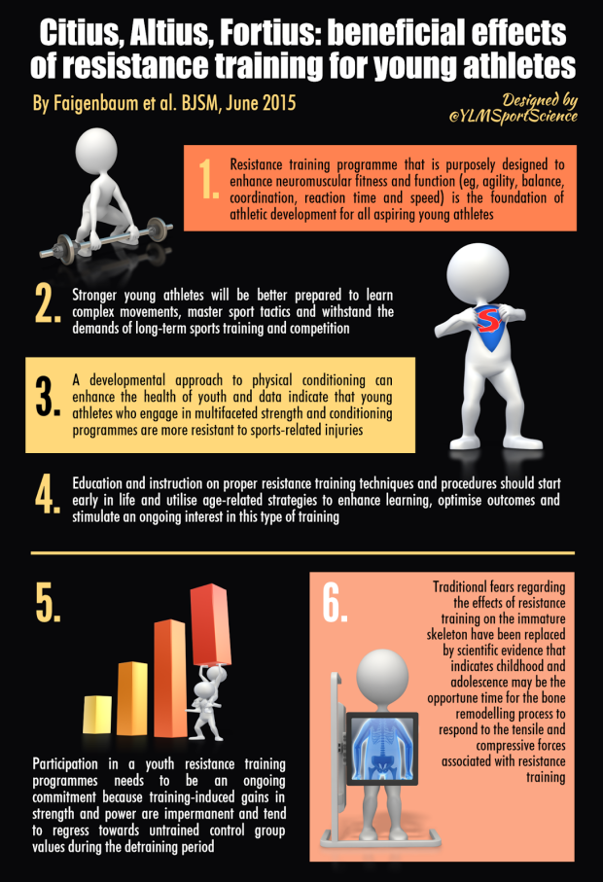
Reality
Resistance training is a foundation for athletic development
Stronger athletes better prepared for harder demands
Improve health and injury risk
Education/Instruction should start early
Participation should be ongoing as adaptations regress with detraining
Traditional fears are unfounded

Slide 25

Myths and fallacies of youth training
Take home messages:
Don’t demonise specific exercises, understand when/why/how to use
Strength training is safe for youth athletes
Strength does not stunt injure growth plates – high impact collisions do!
Youth athletes can benefit from strength training (now/adulthood/old age)
Youth athletes should not just focus on “core” work alone

Slide 26


Slide 27
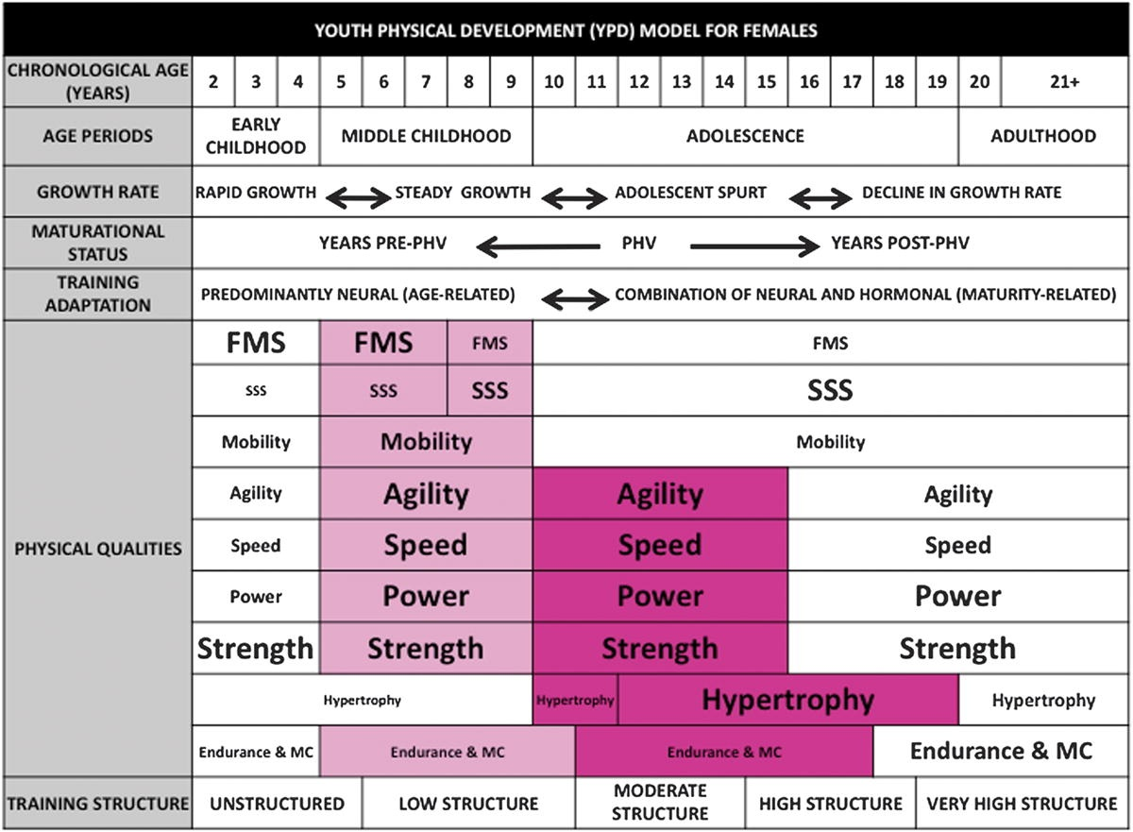
Integrating physical preparation into technical sessions
The Youth Physical Development Model
(YPD) – Lloyd and Oliver 2012

Slide 28
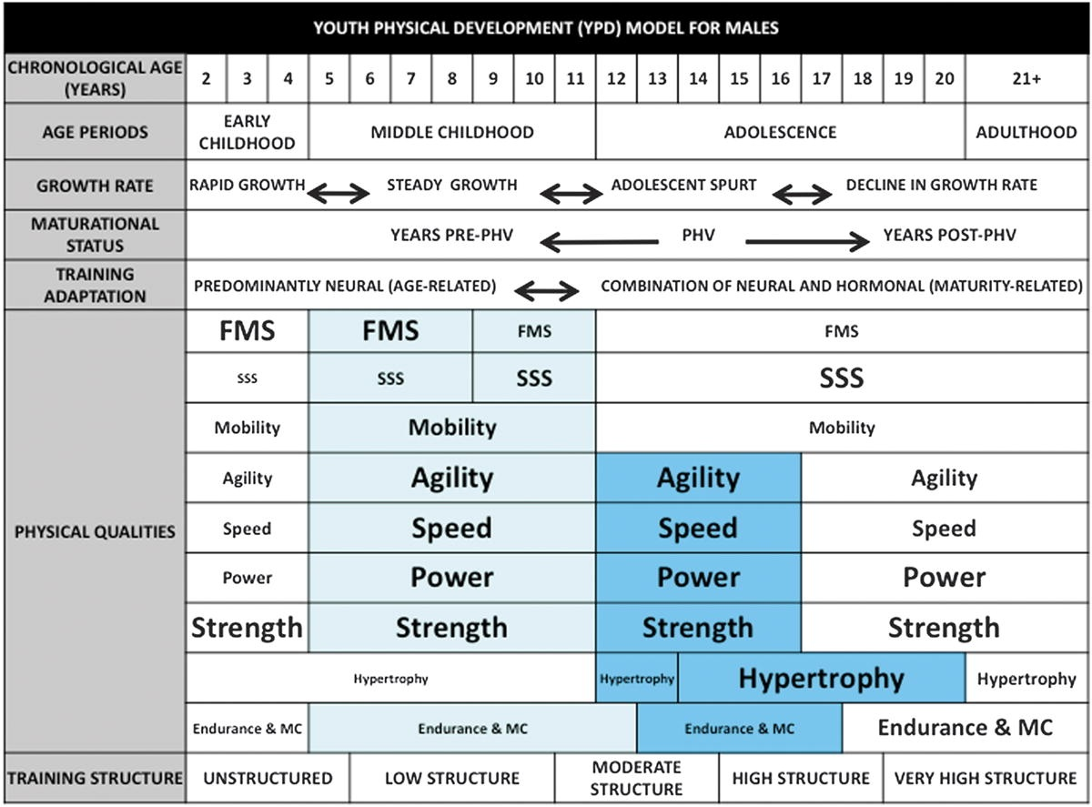
Integrating physical preparation into technical sessions
The Youth Physical Development Model
(YPD) – Lloyd and Oliver 2012

Slide 29
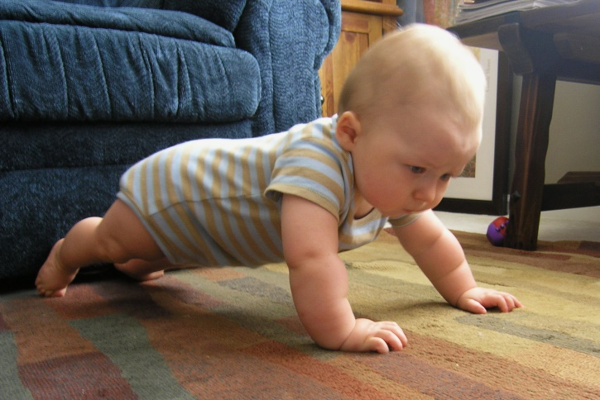
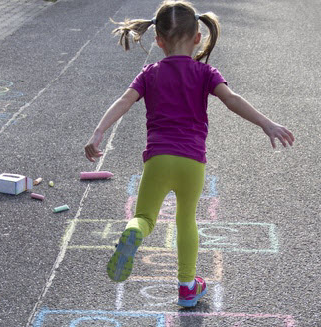

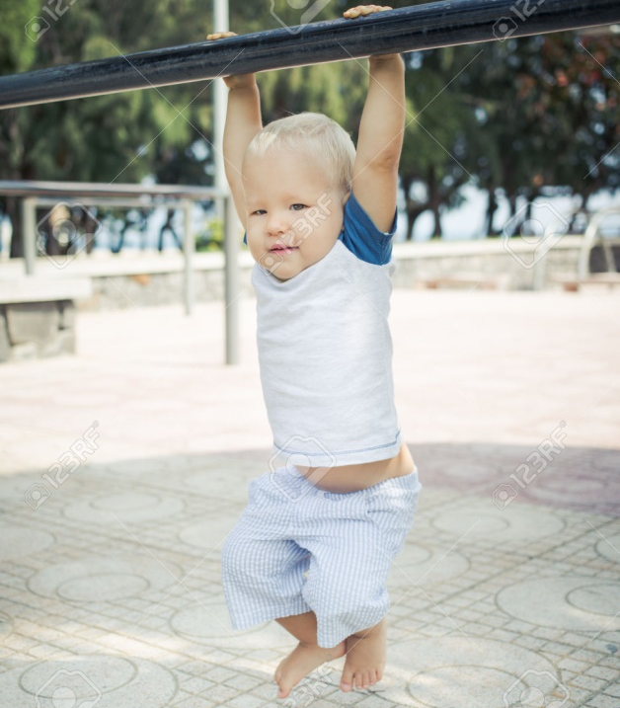
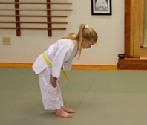
FMS
Brace
Jump and land
Pull
Push
Hip hinge
Squat

Slide 30
Movement skill | Gym Based Example | Field Based Example
Pushing | Vertical - overhead press Horizontal – press up, bench press | ½ press up, press up, throws
Pulling | Rowing exercises Pullups, pull downs | Partner pulling, sled pulling
Bracing | Static – plank, side plank Dynamic – stabilising trunk in other exercises | Planks, side planks, dynamic stabilising in other movements
Squatting (single leg) | Bodyweight squat, goblet squat, overhead squat, front squat, back squat, lunge, step ups, lateral lunge, single leg squat | Bodyweight squat, goblet squat (hold implement), forward lunge, backward lunge, step ups, lateral lunge
Hinging | Romanian deadlift, deadlift, good morning, | Arabesques,
Jumping and landing (single leg) | Counter movement, broad jump, box jump, pogo hops, single leg hop forward/side/zigzag | Counter movement, broad jump, single leg hop forward/side/zig zag

Slide 31
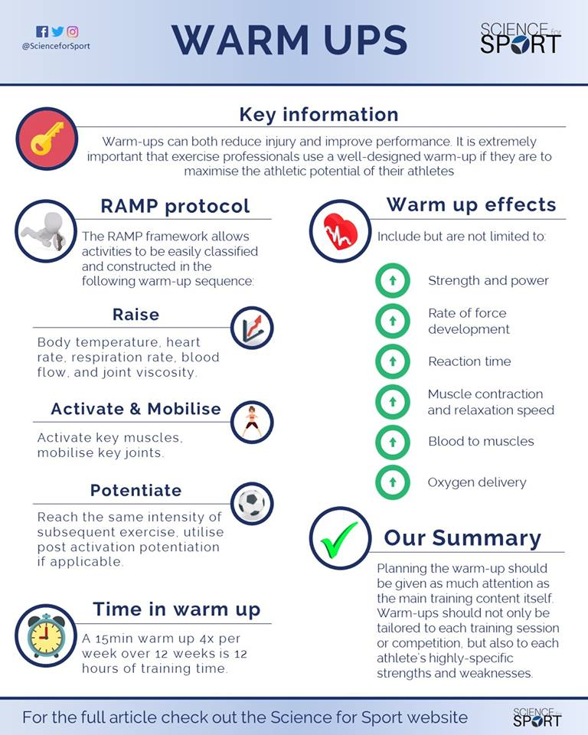
What this looks like in the real world
You don’t need an extra physical training session, use your warm up!
3 x 10 mins = 30 mins/week
3 x 15 mins = 45 mins/week
4 x 10 mins = 40 mins/week
4 x 15 mins = 60 mins/week

Slide 32

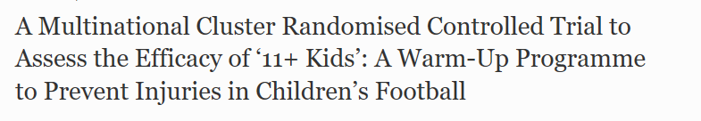
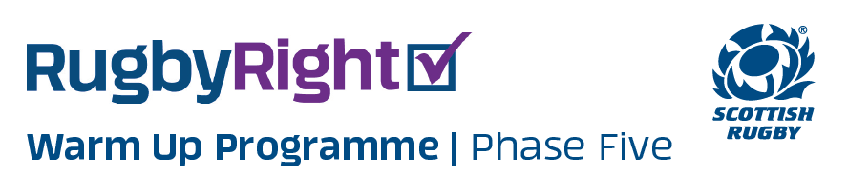
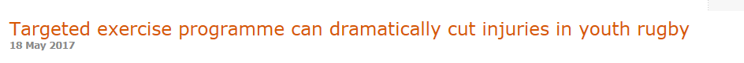

Slide 33
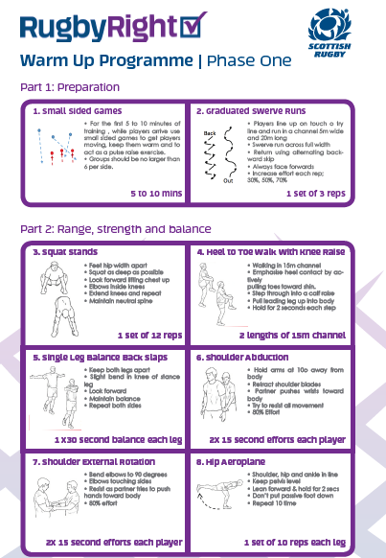

Slide 34
What this looks like in the real world
 | Traditional
Raise | Laps Technical running drills – High knee skip/Straight leg skip etc.
Activate & Mobilise | Circuit of exercises
Potentiate | Few sprints/jumps

Slide 35
What this looks like in the real world
 | Traditional | Creative
Raise | Laps Technical running drills – High knee skip/Straight leg skip etc. | Game based feeding into technical running drill
Activate & Mobilise | Circuit of exercises | Constraint of game, partner based drills, self-selected, animal walks
Potentiate | Few sprints/jumps | Partner based drills, hop and stick variants, addition of challenges, randomised jumps/hurdles

Slide 36
What this looks like in the real world
 | Traditional | Creative | Engaging, Fluid
Raise | Laps Technical running drills – High knee skip/Straight leg skip etc. | Game based feeding into technical running drill | Game based, constraints added to create desired skill (eg. Jumps, blocking session)
Activate & Mobilise | Circuit of exercises | Constraint of game, partner based drills, self-selected, animal walks | Self-selected, self-directed, flow based warm up, build in FMS to technical skill (eg. Lateral lunge – dig; jump/land - block)
Potentiate | Few sprints/jumps | Partner based drills, hop and stick variants, addition of challenges, randomised jumps/hurdles | Shadowed hopping drills Accelerate/decelerate Curved accelerations Sharper accelerations

Slide 37
Checklist
FMS | Warm Up Component | How
Pushing
Pulling
Bracing
Squatting (2 and 1 leg)
Hinging
Jumping and Landing (2 and 1 leg)
*It’s not necessary to cover each component every session. But consider rotating/trying each every week*

Slide 38
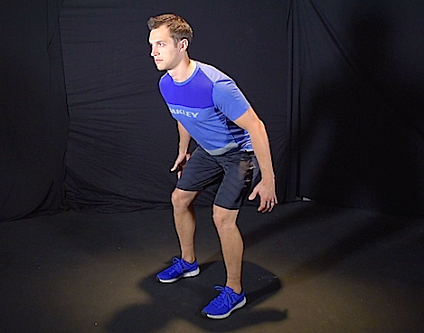
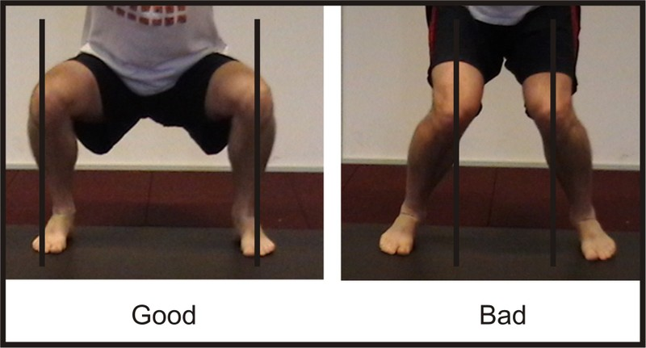
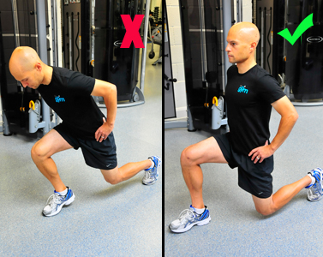
Checklist - Principles
FMS | General Principles
Feet | Stable base, neutral
Knees | Aligned with feet
Hips | Neutral
Shoulders | Neutral over hips
Head | Neutral

Slide 39
Questions?

Slide 40
www.athleticevolution.co.uk
athletic-evolution@outlook.com
Instagram: @athleticevouk
Twitter: @athleticevouk

Slide 41
Practical
Traditional warm up vs more creative
Raise
  Warm up games eg. Corner ball, Knee taps, stuck in the mud, robin hood, oz tag
  Add movement tasks as constraint – eg. 5 squats/lunges/arabesques/
Activate/Mobilise
  Flow warm ups for mobility – NADA flow warm up, Inchworm to spiderman
  Animal shapes for mobility/activation – bear, spider, frog, crab
  Team/partner hurdle drills – forward step overs/lateral step overs
  FMS movements – squat, lunge, lateral lunge, arabesque, press up
  Single leg balance – partner catch/throw, arabesque
Potentiate
  Hop and stick – forward/lateral/zig-zag
  Repeat hops – forward/lateral/zig-zag
  Counter movement jump, broad jump, bunny hops, jumps with rotation, hurdle jump
  Accelerate/decelerate/change direction
  Partner shadow drills/chase

Slide 42
Useful Links:
Growth and maturation monitoring: https://kinesiology.usask.ca/growthutility/phv_ui.php
Strengthlab Primary School Superheroes program:
http://www.strengthlab.co.uk/
International Youth Conditioning Association:
http://iyca.org/
Yann Le Meur Infographics:
https://ylmsportscience.com/?s=youth+athletes
Flow warm up:
https://www.youtube.com/watch?v=lm7jQ92G0AM
Animal walks:
https://www.youtube.com/watch?v=14BjRxE7f1o

Slide 43
References
Bone mineral content in elite junior Olympic weightlifters:
http://europepmc.org/abstract/med/8231753
Physeal injuries in children’s and youth sports:
http://bjsm.bmj.com/content/bjsports/40/9/749.full.pdf
Investigation of growth, development and injury:
https://fortiustrainingblog.files.wordpress.com/2015/12/investigation-of-growth-development-and-factors-associated-with-injury-in-elite-schoolboy-footballers.pdf
Relative age effect in Uefa Championship: https://www.ncbi.nlm.nih.gov/pmc/articles/PMC4633259/
Youth Physical Development Model:
http://static1.1.sqspcdn.com/static/f/1109123/24625383/1395775941037/The+Youth+Physical+Development+Model.pdf?token=H2hNhNZz2cDv3KQlgNWHure3HA0%3D
LTAD Model: Evidence/Application:
http://www.tandfonline.com/doi/pdf/10.1080/02640414.2010.536849
Position stands:
American Academy of Paediatrics
NSCA Position Paper
UKSCA Position Paper
ASCA Position Paper
Bases Position Paper

